Slide 1
How To Sell My Equipment: Evolving Asset Management with Digital Technology
August 2019

Slide 2
We live in a complex world…
…with many priorities, and more everyday

Slide 3
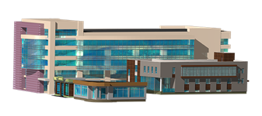
Commonly asked questions by industrial companies
ABC Company
How do I know I’m making the right investments?
What capital projects should I prioritize?
Where are my risks?
How can I improve my operations?
More…
Corporate
How can I ensure my resources are properly trained?
How do I know which assets are more critical than others?
How can I tell where product changes impact
my installed base?
Where should I spend my budget?
More…
Facility
Is this product supported?
Where do I get support?
What services do we have access to?
Where are my L75 Controllers?
More…
Plant Floor
How can I make more informed, data-driven decisions?

Slide 4
Decision making in the past
Rely more on experience when addressing key business issues
64%
Using data for proactive purposes
25%
Using spreadsheets to analyze sensor data
57%
THE PROBLEM ISN’T A LACK OF DATA, IT’S A LACK OF CONNECTIVITY
Sources: IndustryWeek, MESA, ARC

Slide 5
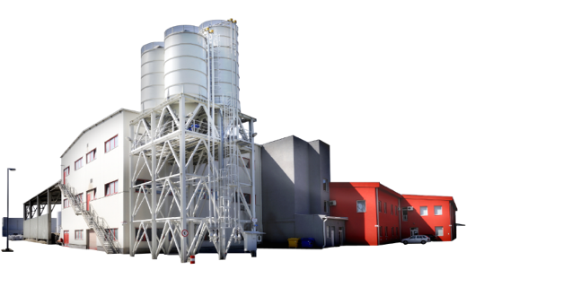
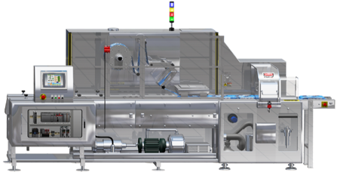
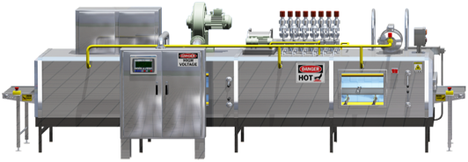
Business risks and drivers
Smart Manufacturing has become a business imperative
$65B Automation systems reaching end of life
~75% U.S. plants are more than 20 years old
$20B cost of unscheduled downtime
2 Exabytes Big data generated in manufacturing
<14 % US Plants completely integrated
21% Suffered a loss of IP in the past year
SOURCE: ARC
SOURCE: Industry Week
SOURCE: ARC
SOURCE: McKinsey
SOURCE: Industry Week
SOURCE: Kaspersky (2014)
Support and Manage Operations Today
Plan and Evolve into Tomorrow
Notes:
Compounding on the issues we just discussed, there are many macro-level business risks and drivers that mandate industry continue to evolve. As a result, decision making must improve, and it must by increasingly anchored in available and insightful data.
<Risks: Changing Risk Patterns and Vulnerabilities >
There are many business risks and drivers that are challenging companies today:
Automation systems have reached end of life, and many of these systems were never designed to be connected to a network and were given no thought to security. (source: ARC study)
75% of plants in the US are over 20 years old - how can you get the information needed securely from those older assets? Can you continue to support them in the long term? (both from a hardware and support personnel perceptive – you don’t want to train your new automation engineers on older legacy equipment) (source: Industry Week)
The cost of downtime is something everyone is concerned with regardless of your industry or products. (source: ARC)
According to a McKinsey & Co. report, manufacturing and industrial operations generate more data than any other industrial sector. However, most of that data today is discarded at run time and is primarily used for diagnostics and alarming - not to drive process or business improvements. In other words, we’re not capturing the true value.
Very few US plants actually have a completely integrated system, less than 14%. (Industry Week)
And many 21% have suffered a loss in their IP in 2014. (source: Kapersky)
Bottom line, if risks are not continually addressed then there can be serious results from incidents (both malicious and unintentional):
loss of IP, exposure to counterfeiting
lost of revenue due to downtime, faulty product, worker injury
brand/image risk—product & worker safety, corporate reputation
All with the costs to modernize/upgrade in mind
PROVOCATION: how are you using the data from connected assets today? Are you driving productivity improvements or simply doing diagnostics and alarming?
<CLICK>

Slide 6
Why Digital Services?
Data Aware
Digital Services delivers a new level of information and productivity. It creates a digital footprint and delivers impactful services to:
Improve operational intelligence
Reduce downtime
Recognize cost savings
Data Informed
Data informed
Then
Now
Data Driven

Slide 7
My Equipment
My Equipment
Right people
Corporate
Plant management
IT / Security
Operations
Maintenance
Right information
Context
Asset attributes
Physical location
Lifecycle information
Right time
Budgeting cycles
Modernization planning
Renewal planning
Inventory purchasing
Asset utilization
Data-driven decisions
Reduce waste
Improve budget utilization
Improve efficiencies
Improve speed
Leverage data to make the right decision, at the right time

Slide 8
Begin with an Installed Base Evaluation™
An Installed Base Evaluation™ (IBE®) is a site-delivered service.
It provides actionable intelligence to help customers make data-driven decisions regarding the support and obsolescence management of their installed base assets.
BETTER UNDERSTAND
Your lifecycle risk by site, area, line, machine, and panel

Slide 9
What does an IBE® tell me?
Reduce costs by identifying and eliminating excess inventory
Increase uptime by ensuring critical spares are on-site to support production and maintenance
Identify and mitigate risks associated with supporting legacy equipment
Gain broader visibility into your facility assets
Identify shortages of spare parts
COMMON DEFINITION
Shared Understanding of Your Assets

Slide 10
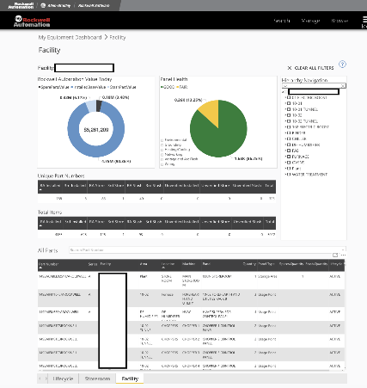
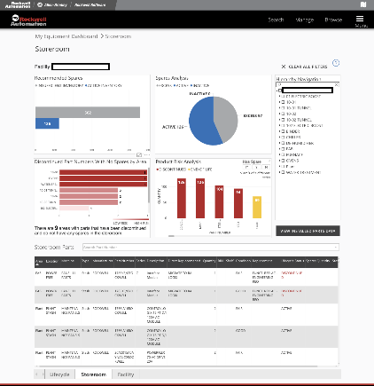
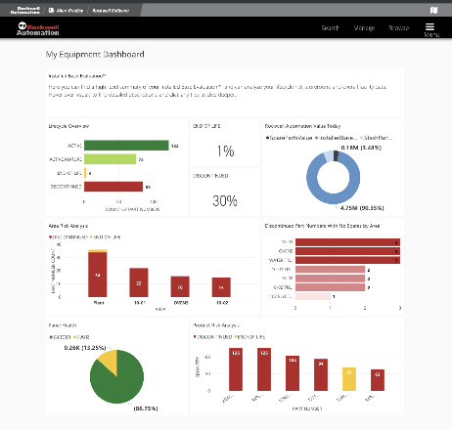
My Equipment
Collaborate with team members through “share” feature
Common asset hierarchy
Real-time view of lifecycle risk with automatic lifecycle updates
Single, verified data source
Accessible across devices

Slide 11
Installed Base Evaluation™ Project Delivery
Onsite Data
Collection
Data Review
And Analysis
Consultative
Report
Delivery
Ongoing
Access to
My Equipment
COMPREHENSIVE FACILITY VIEW
REIVEW AND ASSESS RISK
EVALUATE ONGOING OPPORTUNITIES

Slide 12
Feature and Enhancement Release Schedule
Dec
Nov
Oct
Sept
Aug
8/24
9/7
11/2
My Equipment
Dashboard Enhancements
Call-out of quantity of parts with recent lifecycle changes
Graph of lifecycle changes over time within the facility
My Equipment
Lifecycle Change Notifications
Automatic, curated notification based on lifecycle changes
My Equipment
Product Context Page
Contextualized view of a product and its installed base at a facility
Product information including description, lifecycle status, recently changed status date, repairability status, and more
RAAMP Reports
Entitled access to RAAMP reports and content within My Equipment application

Slide 13
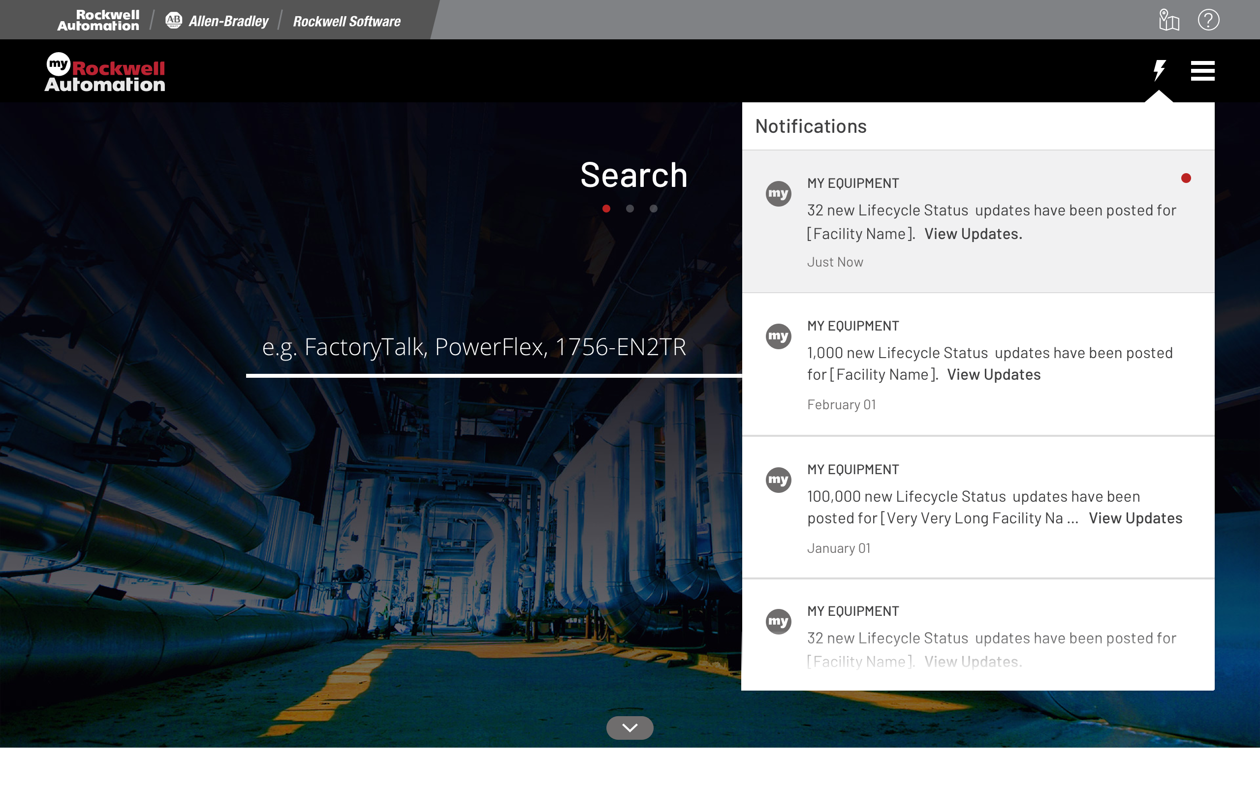
Lifecycle Alert and Notification
Prototype
Get notified when a part in your facility changes lifecycle status!
Automatic Notifications
Updates for only parts in your facility eliminates unnecessary notifications

Slide 14
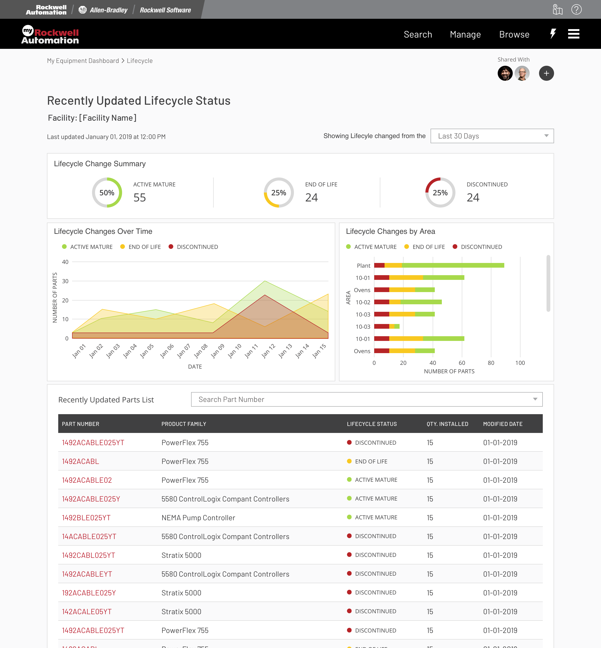
Recently Changed Lifecycle View
Prototype
Assess the impact of obsolescence risk in your facility with a view into recent lifecycle changes
Recent product changes in last 30/60/90 days
Visual impact of these changes within your facility
Changes over time
Lifecycle changes by area of your facility
Detailed view of recently changed parts and quantity installed
Modified date available for historical analysis

Slide 15
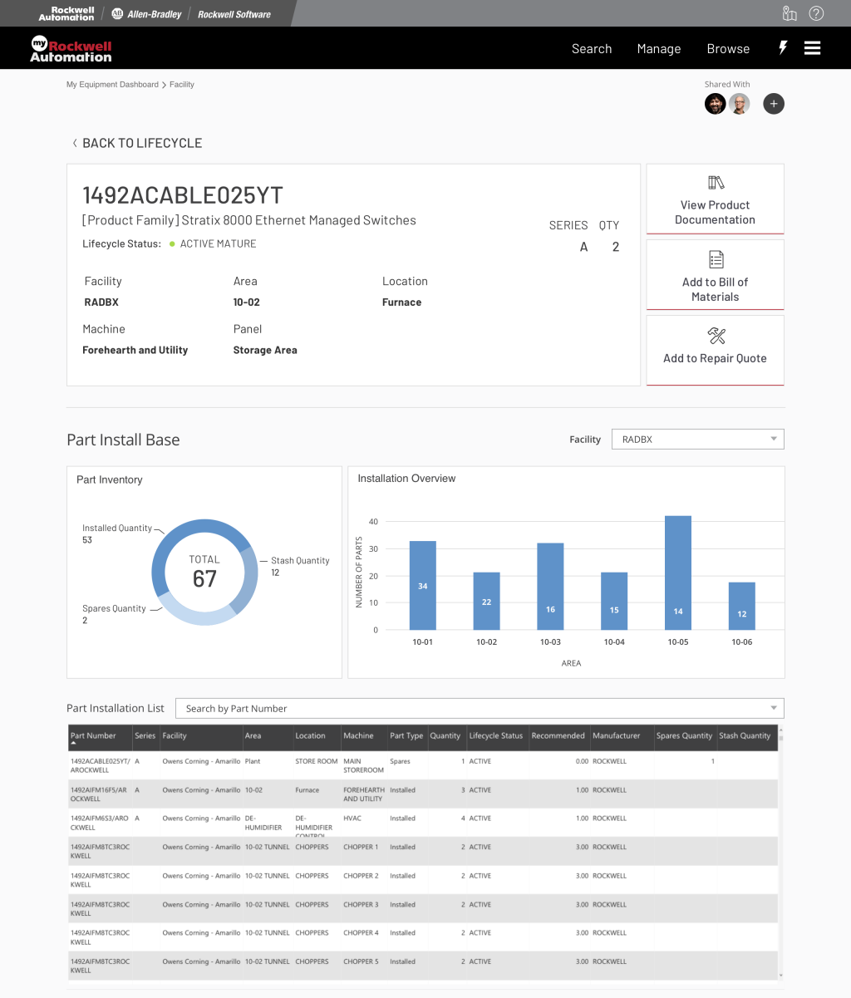
Product Context Page
Prototype
View relevant information of a product and its installed base in your facility!
Quantity Installed
Installed Locations
Product Description
Lifecycle Status
Navigate to common interactions
Add to Repair Quote
Add to BOM
View Product Documentation

Slide 16
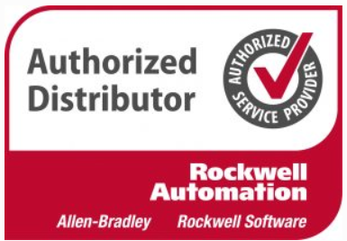
My Equipment – How to Buy
IBE® Sold
Customer Purchases
An IBE®
Inventory Data Collected
Optional Data Collection Refresh
or
Report Delivered
Inbound
Request
Customer Requests thru MyRA
Keep asset inventory up
to date with scheduled
data collection refreshes
Pre-IBE Project Delivery
IBE® Project Delivered
Post-IBE Project Delivery
Motion Generates Interest and Sells IBE
*Price Includes 1 Year Access to My Equipment*
PO Received
Data Collected and Report Delivered
Access Granted to My Equipment upon Report Delivery
List Price: $1,500 per site annually
Access Term: 1 Year
Access Rights: My Equipment
Optional Data Collection Refresh Keeps Asset Inventory Updated

Slide 17
Industries to Target
Food & Beverage
Consumer Goods
Automotive
Household and Personal Care
Pulp and Paper
Print and Publishing
Fiber and Textile
Life Sciences
Others…
Customers with dense installed base of assets across many product lifecycles looking to gain insight across their facility
SEGMENT
Your customers by industry

Slide 18
Differentiators
Comprehensive listing of plant assets – Rockwell Automation and third-party
Provides full lifecycle status of customer’s assets
Enables us to create a risk-mitigating modernization plan
Enables a strong MRO strategy around supporting plant assets
Deliver analysis and reports on and ongoing basis via My Equipment
WHAT SETS US APART?
Provides complete plant hierarchy, facility risk profile, and enriched insights

Slide 19
Qualifying Questions to Ask
Do you have an accurate plant model identifying all physical assets?
Do you have a Bill of Materials (BOM) of all parts that are associated with critical assets in your plants?
Do you have accurate lifecycle information on your aged equipment?
Do you have a standard process for maintaining your storeroom to support critical spares?
AS YOU QUALIFY CUSTOMERS
Contact your Local Services Specialist with Questions

Slide 20
Information needed for quote
Understanding of the customer’s goals
Obsolescence mitigation/migration
Spares rationalization
Customer budgeting requirements
Partial site vs. complete site collection
Identification of the level of collection
Level 1, 2, 3, or 4
Based upon level of detail required
Determination of panel count
Determined by level of collection and increases when adding a 3rd party, MCC section vs. bucket
QUOTES PROVIDED
through the Services Proposal Tool

Slide 21
Additional Questions?
Please refer to the FAQ posted on Seismic for answers to more detailed questions
There is also a My Equipment Launch Kit on Seismic in News Center

Slide 22
Thank you

